Slide 1
Location services

Slide 2
Create an app that displays the current location (latitude and longitude) of the device.
Add these two permissions to the AndroidManifest.xml
<uses-permission android:name="android.permission.ACCESS_FINE_LOCATION"/>
This permission allows your app to access precise location information. It typically uses GPS (Global Positioning System) or other satellite-based systems to determine the device's location with high accuracy, usually within a few meters.

Slide 3
AndroidManifest.xml
<uses-permission android:name="android.permission.ACCESS_COARSE_LOCATION"/>
This permission allows your app to access approximate location information. It generally uses Wi-Fi and cellular network data to triangulate the device's location, which can be accurate within several hundred meters to a few kilometers.

Slide 4
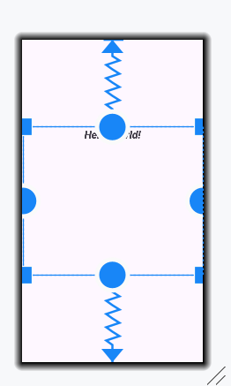
activity_main.xml
Insert a TextView (id: locationTextView) to the interface
This textview displays the latitude and longitude.

Slide 5
MainActivity.java
Refer the file attached

Slide 6
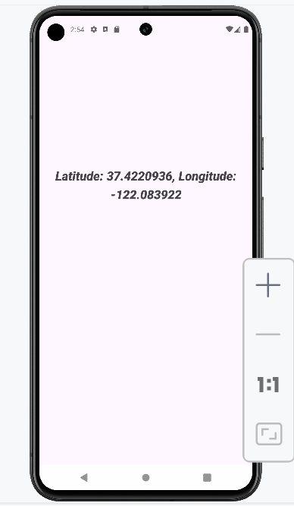
Output

